Slide 1

DBMS PROJECT
course code: CT-261
E-COMMERCE MANAGEMENT SYSTEM
MADE BY:
MUHAMMAD HAMZA KHAN(DT-48)

Slide 2

ABSTRACT
This project outlines the design and implementation of an E- commerce Management database, aimed at supporting the operations of an e-commerce plattform. The database schema is carefully designed to capture various aspects of the E-commerce business, including customer details, seller information, product inventory, shopping carts, orders, payments, and more

Slide 3
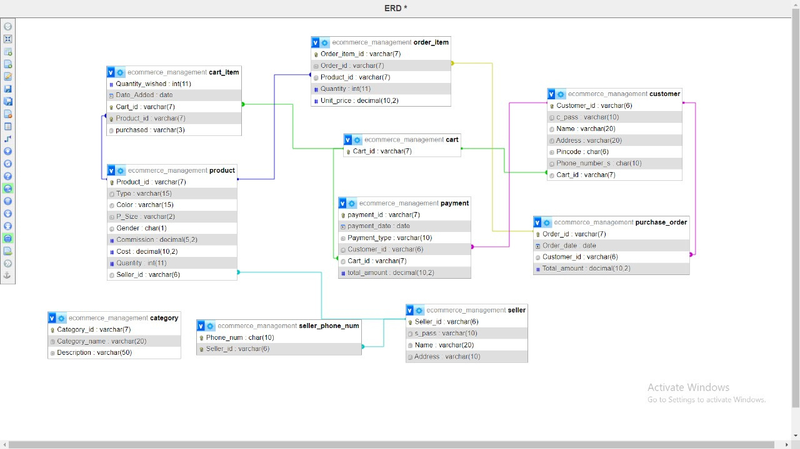
ENTITY RELATION DIGRAM

Slide 4
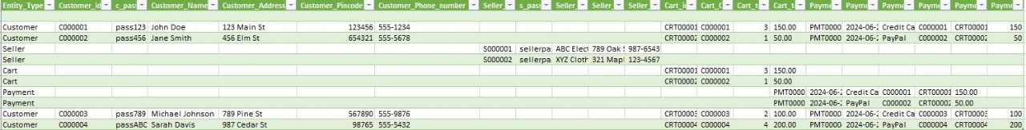
UN NORMALIZATION FORM

Slide 5
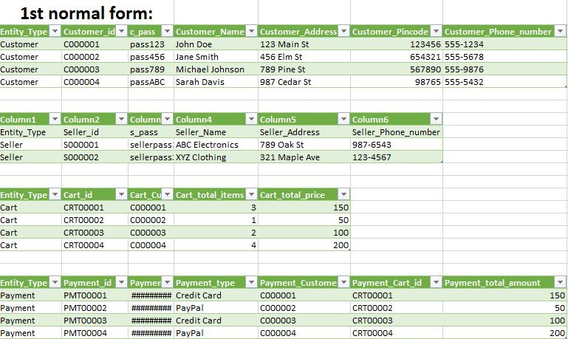
1ST NORMAL FORM

Slide 6
2ND NORMAL FORM
Actions Taken:
Identify Primary Keys: Ensure each table has a clear primary key.
Remove Partial Dependencies: Ensure all non-key attributes are
fully dependent on the primary key.
2NF Review: In the given tables, no new tables are needed since all non-key attributes are already fully dependent on their respective primary keys.

Slide 7
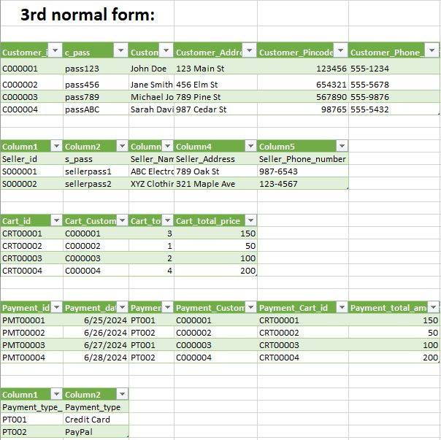
3RD NORMAL FORM

Slide 8
DDL OPERATIONS
Data Definition Language (DDL) operations were performed to create, alter, and manage the database schema. Examples include creating tables, adding constraints, modifying columns, and managing indexes. The DDL queries ensure the structural foundation required for robust data management.

Slide 9
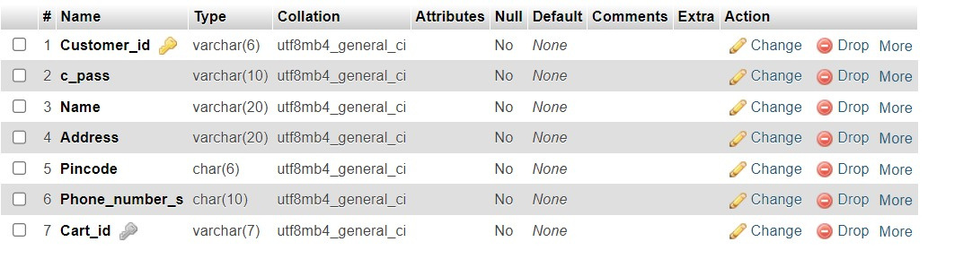
CREATE TABLE Customer (
Customer_id VARCHAR(6) PRIMARY KEY,
c_pass VARCHAR(10) NOT NULL,
Name VARCHAR(20) NOT NULL,
Address VARCHAR(20) NOT NULL,
Pincode CHAR(6) NOT NULL,
Phone_number_s CHAR(10) NOT NULL,
Cart_id VARCHAR(7) NOT NULL,
FOREIGN KEY (Cart_id) REFERENCES Cart(Cart_id)
);

Slide 10
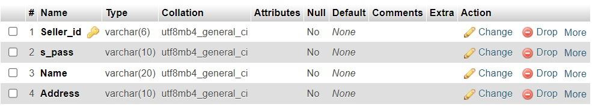
CREATE TABLE Seller (
Seller_id VARCHAR(6) PRIMARY KEY,
s_pass VARCHAR(10) NOT NULL,
Name VARCHAR(20) NOT NULL,
Address VARCHAR(10) NOT NULL
);

Slide 11
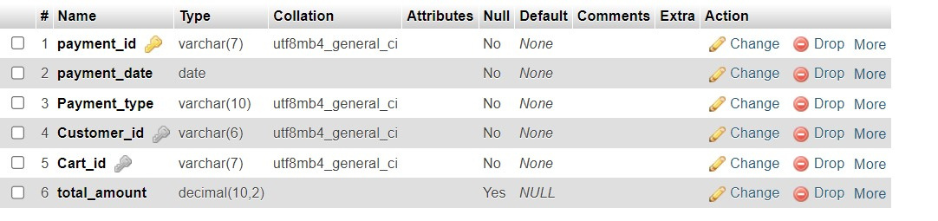
CREATE TABLE Payment (
payment_id VARCHAR(7) PRIMARY KEY,
payment_date DATE NOT NULL,
Payment_type VARCHAR(10) NOT NULL,
Customer_id VARCHAR(6) NOT NULL,
Cart_id VARCHAR(7) NOT NULL,
FOREIGN KEY (Customer_id) REFERENCES Customer(Customer_id),
FOREIGN KEY (Cart_id) REFERENCES Cart(Cart_id),
total_amount DECIMAL(10, 2)
);

Slide 12
DML OPERATIONS
Data Manipulation Language (DML) operations were conducted to insert, update, delete, and query data within the database. These operations facilitate the daily interactions with the database, enabling functionalities such as adding products to carts, placing orders, processing payments, and retrieving order histories.

Slide 13
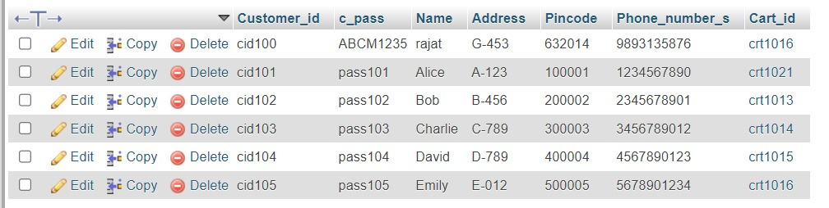
INSERT INTO Customer (Customer_id, c_pass, Name, Address, Pincode, Phone_number_s, Cart_id)
VALUES
('cid101', 'pass101', 'Alice', 'A-123', '100001', '1234567890', 'crt1012'),
('cid102', 'pass102', 'Bob', 'B-456', '200002', '2345678901', 'crt1013'),
('cid103', 'pass103', 'Charlie', 'C-789', '300003', '3456789012', 'crt1014'),
('cid100', 'ABCM1235', 'rajat', 'G-453', '632014', '9893135876', 'crt1016'),
('cid104', 'pass104', 'David', 'D-789', '400004', '4567890123', 'crt1015'),
('cid105', 'pass105', 'Emily', 'E-012', '500005', '5678901234', 'crt1016');
UPDATE Customer SET Cart_id = 'crt1021' WHERE Customer_id = 'cid101'

Slide 14
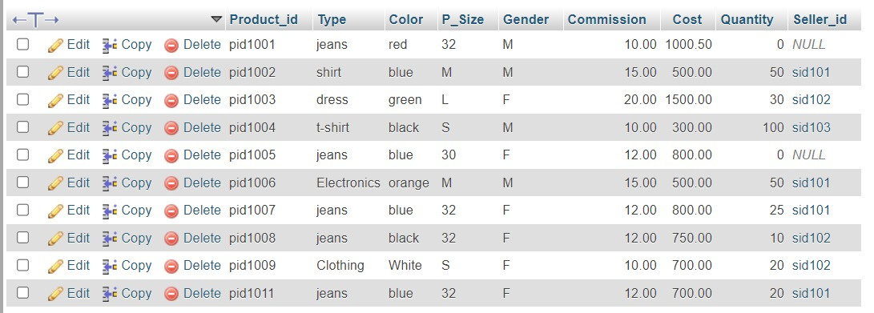
INSERT INTO Product (Product_id, Type, Color, P_Size, Gender, Commission, Cost, Quantity, Seller_id)
VALUES
('pid1006', 'Electronics', 'orange', 'M', 'M', 15, 500, 50, 'sid101'),
('pid1002', 'shirt', 'blue', 'M', 'M', 15, 500, 50, 'sid101'),
('pid1003', 'dress', 'green', 'L', 'F', 20, 1500, 30, 'sid102'),
('pid1004', 't-shirt', 'black', 'S', 'M', 10, 300, 100, 'sid103'),
('pid1005', 'jeans', 'blue', '30', 'F', 12, 800, 25, 'sid100'),
('pid1001', 'jeans', 'red', '32', 'M', 10, 1000.5, 20, 'sid100'),
('pid1007', 'jeans', 'blue', '32', 'F', 12, 800, 25, 'sid101'),
('pid1008', 'jeans', 'black', '32', 'F', 12, 750, 10, 'sid102'),
('pid1009', 'Clothing', 'White', 'S', 'F', 10, 700, 20, 'sid102'),
('pid1011', 'jeans', 'blue', '32', 'F', 12, 700, 20, 'sid101');

Slide 15
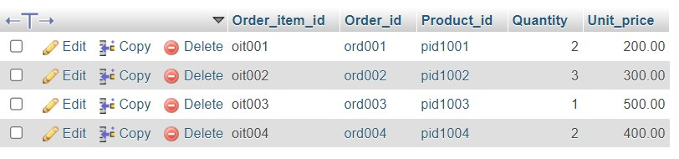
INSERT INTO Order_Item (Order_item_id, Order_id, Product_id, Quantity, Unit_price)
VALUES
('oit001', 'ord001', 'pid1001', 2, 200),
('oit002', 'ord002', 'pid1002', 3, 300),
('oit003', 'ord003', 'pid1003', 1, 500),
('oit004', 'ord004', 'pid1004', 2, 400);

Slide 16
JOINS
Joins are used to combine rows from two or more tables based on a related column between them. Joins allow you to retrieve data that is spread across multiple tables in a relational database.

Slide 17
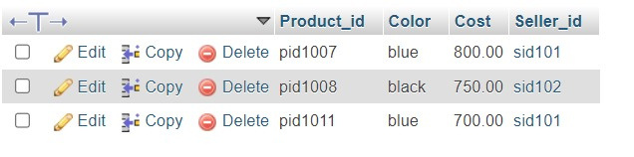
SELECT Product_id, Color, Cost, Seller_id
FROM Product
WHERE Type = 'jeans' AND P_Size = '32' AND Gender = 'F' AND Quantity > 0;

Slide 18

SELECT oi.Product_id, oi.Quantity, po.Order_date, oi.Unit_price
FROM Purchase_Order po
JOIN Order_Item oi ON po.Order_id = oi.Order_id
WHERE po.Customer_id = 'cid101';

Slide 19

SELECT po.Order_id, po.Order_date, oi.Product_id, oi.Quantity, oi.Unit_price, p.Type, p.Color
FROM Purchase_Order po
JOIN Order_Item oi ON po.Order_id = oi.Order_id
JOIN Product p ON oi.Product_id = p.Product_id
WHERE po.Customer_id = 'cid101';

Slide 20
THANK YOU !

